Slide 1

CZ3005 Artificial Intelligence Constraint satisfaction and adversarial search
Asst/P Hanwang Zhang
https://personal.ntu.edu.sg/hanwangzhang/
Email: hanwangzhang@ntu.edu.sg
Office: N4-02c-87

Slide 2
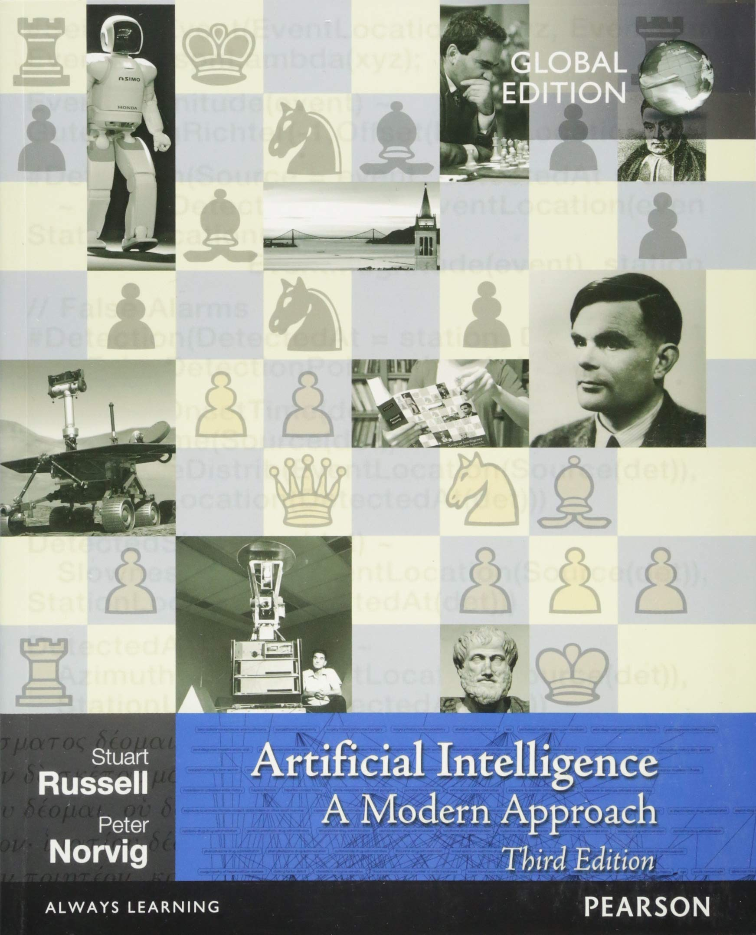
Lesson Outline
Constraint Satisfaction
Adversarial search (Game Playing)

Slide 3
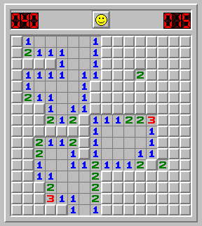
Constraint Satisfaction Problem (CSP)
Goal: discover some state that satisfies a given set of constraints
Example: Sudoku
Example: Minesweeper
R
R
 |  |  |  |  |  |  | 1 | 3
 |  |  | 7 |  |  |  |  | 6
 |  |  | 5 |  | 9
 |  |  |  |  |  | 9
1 |  | 6
 |  |  |  |  |  | 2
7 | 4 |  |  |  |  |  | 5
 | 8 |  |  |  |  | 4
 |  |  |  | 1

Slide 4
Examples: Real-world CSPs
Assignment problems
e.g. who teaches what class
Timetabling problems
e.g. which class is offered when and where?
Hardware configuration
Transportation scheduling
Factory scheduling
Floor-planning
Notes:
Anymore? Any search with a goal is a constraint search. You can always set up a goal threshold > 0. salary > 10k, bonus > 12 month, working time < 4 hours/week, paid leave > 1 month.

Slide 5
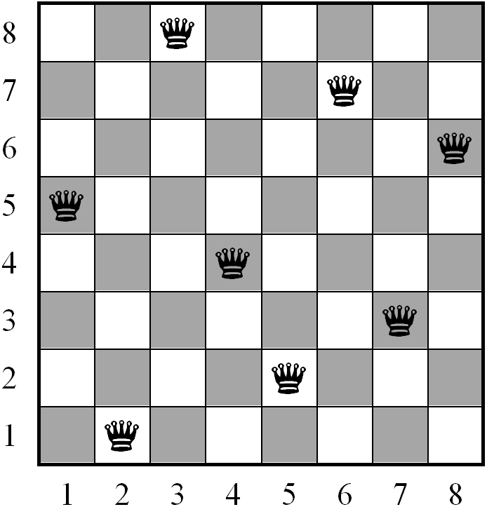
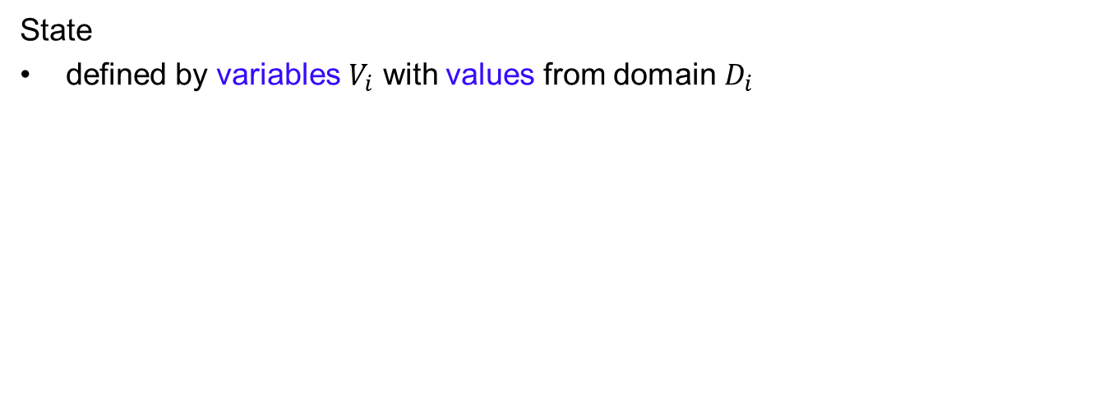
CSP
State
defined by variables $V_{i}$ with values from domain${ D}_{i}$
Example: 8-queens
Variables: locations of each of the eight queens
Values: squares on the board
Goal test
a set of constraints specifying allowable combinations of values for subsets of variables
Example: 8-queens
R
Goal test: No two queens in the same row, column or diagonal

Slide 6
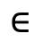
Example: Cryptarithmetic Puzzle
S E N D
+ M O R E
M O N E Y
Variables: D, E, M, N, O, R, S, Y
Value Domain: {0, 1, 2, 3, 4, 5, 6, 7, 8, 9}
Constraints
Y = D + E or Y = D + E - 10, etc
D ≠ E, D ≠ M, D ≠ N, etc.
M ≠ 0, S ≠ 0 (unary constraints: concern the value of a single variable)
$$∈$$
Notes:
Solving for M first. M = 1, O = 0, S = 9. decimal, carry digit

Slide 7
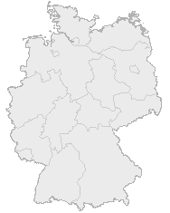
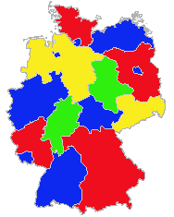
Example: Map Colouring
Colour a map so that no adjacent parts have the same colour
Variables: Countries Ci
Domains: {Red, Blue, Green}
Contraints: C1 ≠ C2, C1 ≠ C5, etc.
binary constraints

Slide 8
Some Definitions
A state of the problem is defined by an assignment of values to some or all of the variables.
An assignment that does not violate any constraints is called a consistent or legal assignment.
A solution to a CSP is an assignment with every variable given a value (complete) and the assignment satisfies all the constraints.
Notes:
Assignment: 8 queuen or anygame as an example.

Slide 9
Applying Standard Search
States: defined by the values assigned so far
Initial state: all variables unassigned
Actions: assign a value to an unassigned variable
Goal test: all variables assigned, no constraints violated

Slide 10
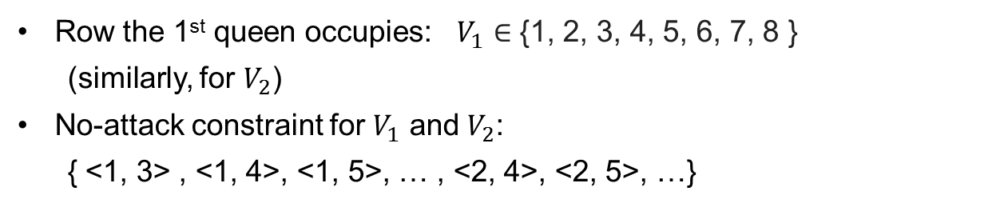
Applying Standard Search
Question: How to represent constraints?
Answer: Explicitly (e.g., D ≠ E)
Example
R
Row the 1st queen occupies: $V_{1}$ ∈ {1, 2, 3, 4, 5, 6, 7, 8 }
(similarly, for $V_{2}$)
No-attack constraint for $V_{1}$ and $V_{2}$:
{ <1, 3> , <1, 4>, <1, 5>, … , <2, 4>, <2, 5>, …}
Implicitly: use a function to test for constraint satisfaction
Notes:
you can consider that Explicit means before you take the action, your action choice is constrained. Implicit means your action is not constrained, but you will be penalized later for improper constraints. The Minesweeper is implicit version.
Explicit and implicit not a big deal, Mathmatically, Larange multiplier is from explicit to implicit.

Slide 11
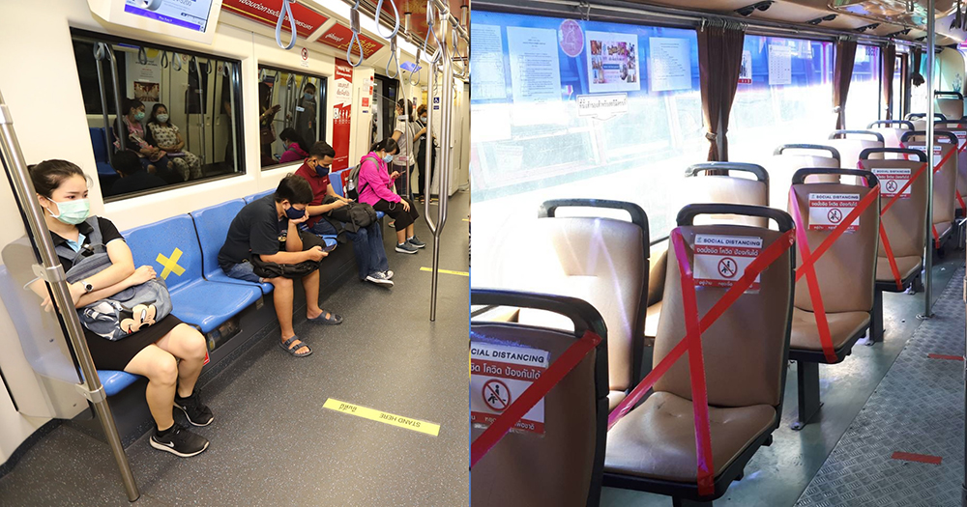
Explicit or Implicit?
Notes:
Left: implicit
Right: explicit

Slide 12
Backtracking Search
Backtracking search: Do not waste time searching when constraints have already been violated
Before generating successors, check for constraint violations
If yes, backtrack to try something else
Initial State
S1
Go back to the last decision point
S2
X
Something goes wrong

Slide 13



Example (4-Queens)

Slide 14
Heuristics for CSPs
Plain backtracking is an uninformed algorithm!!
More intelligent search that takes into consideration
Which variable to assign next
What order of the values to try for each variable
Implications of current variable assignments for the other unassigned variables
forward checking and constraint propagation
Constraint propagation: propagating the implications of a constraint on one variable onto other variables
Notes:
The first two may require domain specific knowledge

Slide 15
Example (4-Queens) without Constraint Propagation
Notes:
do you see any redundancy?

Slide 16
Search Tree of 4-Queens with Constraint Propagation

Slide 17

Example (Map Colouring)
NT
Northern
Territory
Q
Queensland
WA
Western
Australia
South
Australia
NSW
SA
New South Wales
V
Victoria
T
Tasmania

Slide 18
Example (Map Colouring)...
NT
Q
WA
SA
NSW
V
T
WA
NT
Q
NSW
V
SA
T

Slide 19
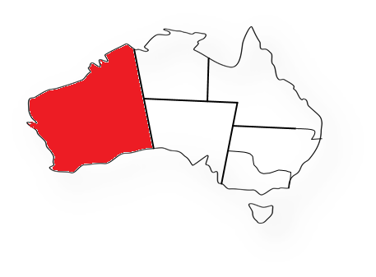
Example (Map Colouring)...
WA
NT
Q
NSW
V
SA
T

Slide 20
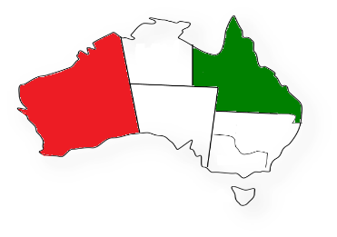
Example (Map Colouring)...
WA
NT
Q
NSW
V
SA
T

Slide 21
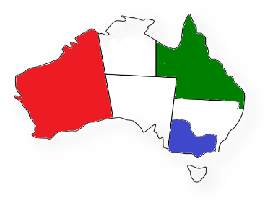
Example (Map Colouring)...
WA
NT
Q
NSW
V
SA
T

Slide 22
Search Tree of 4-Queens with Constraint Propagation
Notes:
Which branch go first?

Slide 23
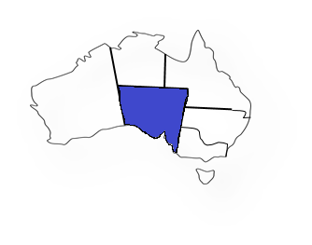
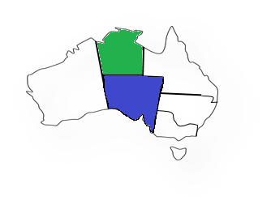
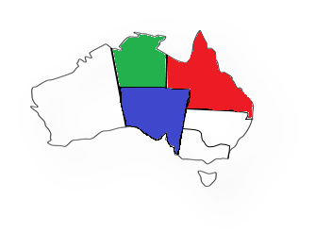
Most Constraining Variable
Example: map colouring
R
To reduce the branching factor on future choices by selecting the variable that is involved in the largest number of constraints on unassigned variables.
Notes:
hardest first: what is the heuristics? Think of the case when you do homework: you choose the hardest first or easiest first? In exam?
Think of a case when ”most” is not applicable? When you cannot determine the “most”.

Slide 24
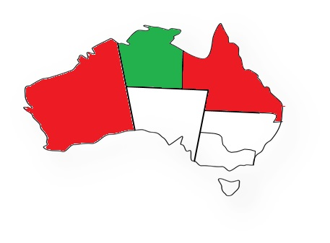
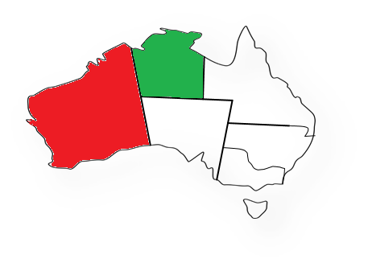
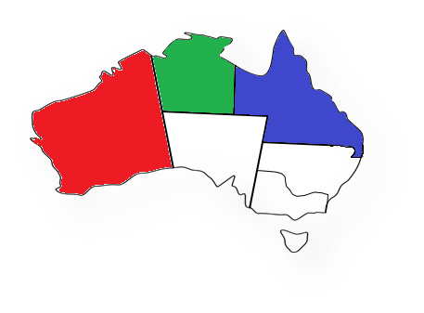
Least Constraining Value
Allow 1 value for SA
Allow 0 values for SA
Choose the value that leaves maximum flexibility for subsequent variable assignments

Slide 25
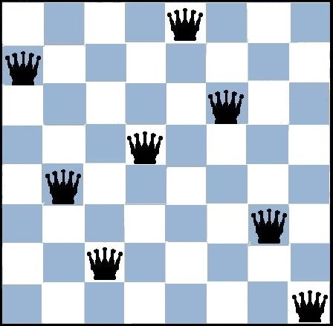
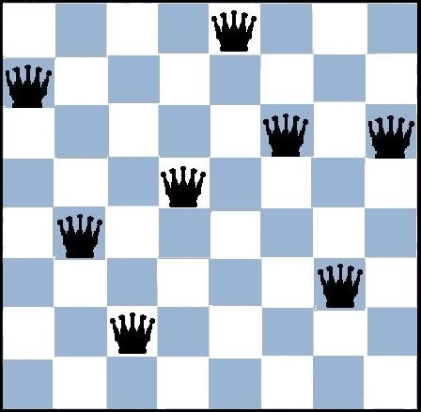
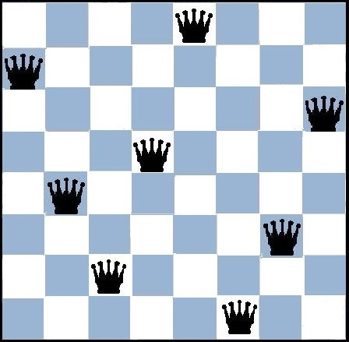
Min-Conflicts Heuristic (8-queens)
A local heuristic search method for solving CSPs
Given an initial assignment, selects a variable in the scope of a violated constraint and assigns it to the value that minimises the number of violated constraints
2
3
2
3
1
2
2
3
3
1
2
2
3
0
Notes:
Steps: 1. apply simple but constraint-violating "solutions"
2. and then, choose the min-conflict one, revise it.

Slide 26



CZ3005 Artificial Intelligence Adversarial Search

Slide 27
Games as Search Problems
Abstraction
Ideal representation of real world problems
e.g. board games, chess, go, etc. as an abstraction of war games
Perfect information, i.e. fully observable
Accurate formulation: state space representation
Uncertainty
Account for the existence of hostile agents (players)
Other agents acting so as to diminish the agent's well-being
Uncertainty (about other agents' actions):
not due to the effect of non-deterministic actions
not due to randomness
→ Contingency problem
Notes:
Your opponent will not react as what you expect!
For example, why sometimes, a noob may win a pro? Your strategy is based on the over-estimation of your opponent’s move.

Slide 28
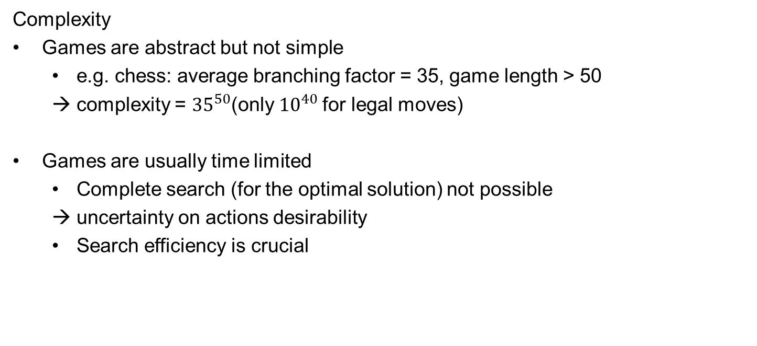
Games as Search Problems...
Complexity
Games are abstract but not simple
e.g. chess: average branching factor = 35, game length > 50
complexity = ${35}^{50}$(only ${10}^{40}$for legal moves)
Games are usually time limited
Complete search (for the optimal solution) not possible
→ uncertainty on actions desirability
Search efficiency is crucial
Notes:
why efficiency, you opponnet cannot wati for a year for you to compute for an answer.

Slide 29
Types of Games
Deterministic
Chance
Chess, Checkers,
Go, Othello
Backgammon,
Monopoly
Perfect information
Bridge, Poker, Scrabble, Nuclear war
Imperfect information
In this course, we only focus on Perfect information
each player has complete information about his opponent's position and about the choices available to him
Notes:
i will upload the paper for poker. For imperfect information, we need game theory.

Slide 30
Game as a Search Problem
Initial state: initial board configuration and indication of who makes the first move
Operators: legal moves
Terminal test: determines when the game is over
states where the game has ended: terminal states
Utility function (payoff function): returns a numeric score to quantify the outcome of a game
Example: Chess
R
Win (+1), loss(-1) or draw (0)
Notes:
First turn or not
Utility function

Slide 31
Game Tree for Tic-Tac-Toe
MAX(X)
MIN(O)
X
 | X
 |  | X
X
 | X
 |  | X
X
 | X
 |  | X
MAX(X)
X | O
X |  | O
X
O
…
The utility value of the terminal state is from the point of view of MAX
MAX uses the search tree to determine the best move
MIN(O)
X | O | X
X | O
X
X | O
 | X
…
…
…
…
…
TERMINAL
X | O | X
 | O | X
 | O
X | O | X
O | O | X
X | X | O
X | O | X
 | X
X | O | O
…
Utility
-1
0
+1
Notes:
Different from normal search which just choose a greedy estimation value, in adversarial search, we need adversarial search strategy.
How to read this tree? We have two points of view, Max and Min, hostile.
There is a utility value for each move and its corresponding state.
Where to put first X? The max value.
Where does the value comes from? From your opponent’s most adversed move. That is, each value is from the win rate minimized by your opponent. So, each value is the try-hard value from your opponent.
Symmetry.

Slide 32
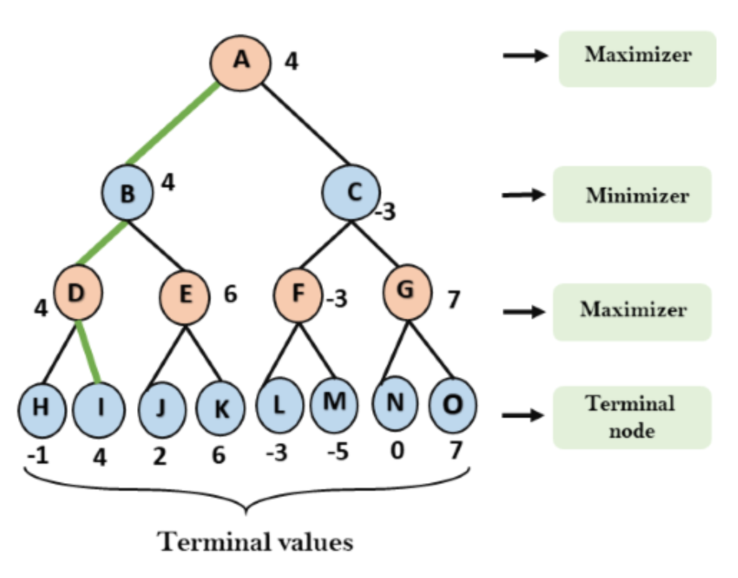
A Toy Min-Max Example

Slide 33
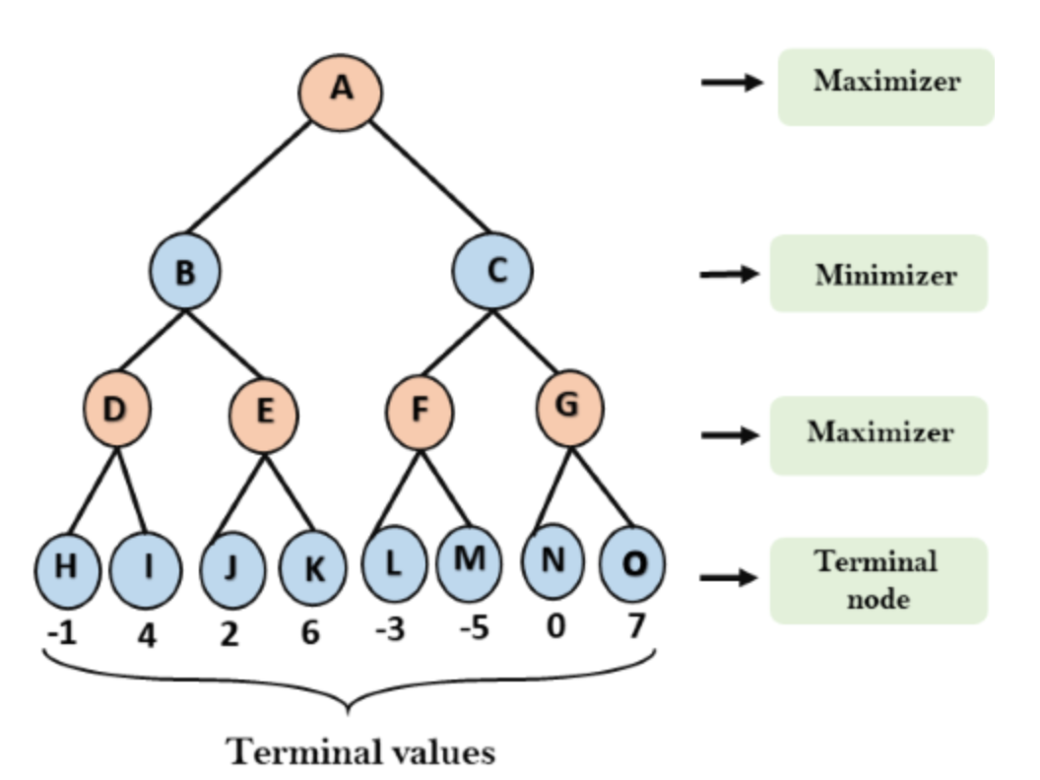
A Toy Min-Max Example
Step 1:
Expand the whole game tree.
Initialize each node to –Inf for max
+Inf for min

Slide 34
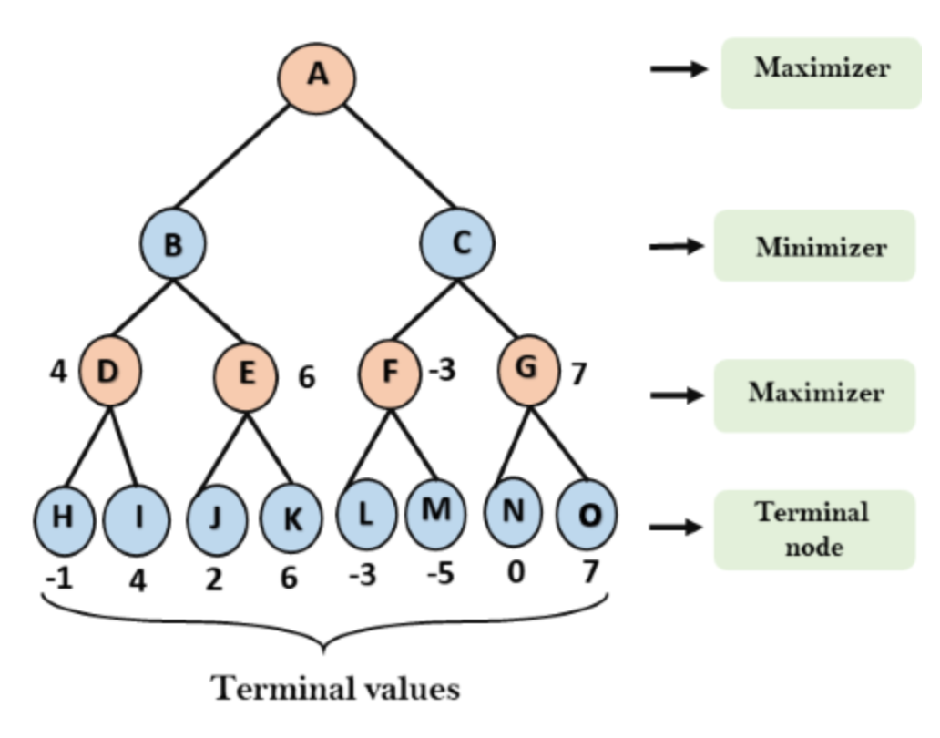
A Toy Min-Max Example
Step 2:
Update the value from btm to top
e.g., for node D:
We want to win→max the value (-1, 4)

Slide 35
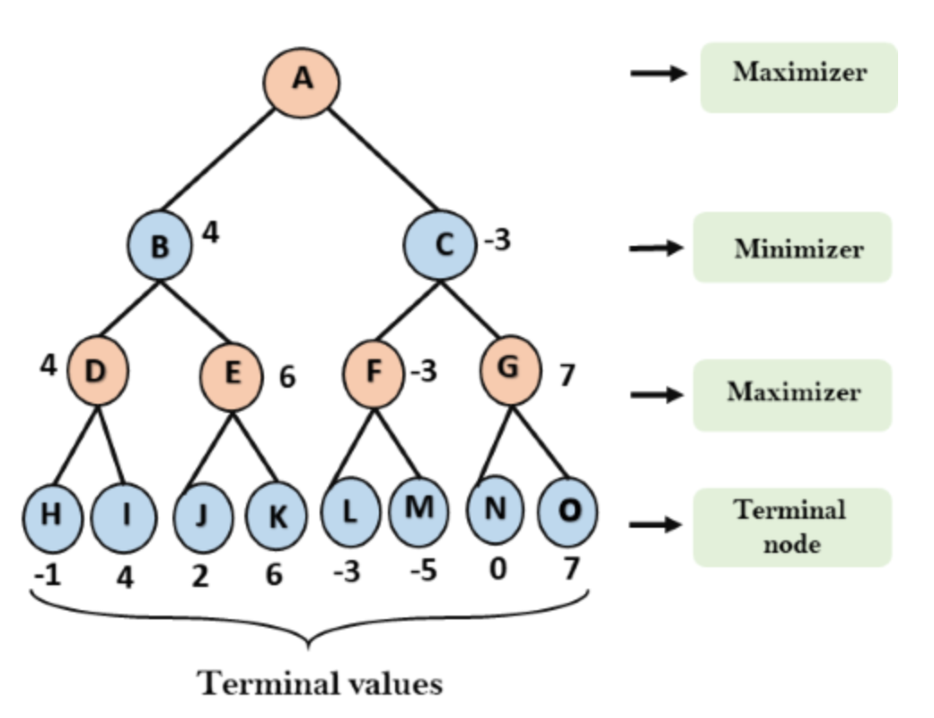
A Toy Min-Max Example
Step 2:
Update the value from btm to top
e.g., for node D:
I want to win→max the value (-1, 4)
e.g., for node B:
You want me to lose → min the value (4, 6)

Slide 36
A Toy Min-Max Example
Notes:
The tree is very robust, even if a noob move, you can even have larger values.
On the other hand, a pro player may be hurt by the noob player in terms of overall utility value. For example, in the pro player’s analysis, he would not go to C as at C, his opponent would definitely go for -3. So, he is too cautious and overestimate the opponent that C is only -3.

Slide 37
Minimax Search Strategy
Search strategy
Find a sequence of moves that leads to a terminal state (goal)
Minimax search strategy
Maximise one's own utility and minimise the opponent's
Assumption is that the opponent does the same

Slide 38
Minimax Search Strategy
3-step process
Generate the entire game tree down to terminal states
Calculate utility
Assess the utility of each terminal state
Determine the best utility of the parents of the terminal state
Repeat the process for their parents until the root is reached
Select the best move (i.e. the move with the highest utility value)

Slide 39
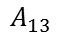
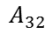
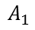
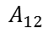
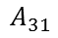
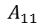
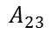
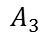
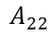
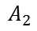
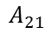
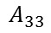
Perfect Decisions by Minimax Algorithm
Perfect decisions: no time limit is imposed
generate the complete search tree
Two players: MAX and MIN
Example
R
MAX
3
$$A_{1}$$
$$A_{3}$$
$$A_{2}$$
MIN
3
2
2
Choose move with best achievable payoff against best play
MAX tries to max the utility, assuming that MIN will try to min it
$$A_{11}$$
$$A_{12}$$
$$A_{13}$$
$$A_{21}$$
$$A_{22}$$
$$A_{23}$$
$$A_{31}$$
$$A_{32}$$
$$A_{33}$$
3
12
8
2
4
6
14
5
2
Notes:
So, for some of the simple games, it will become a turn-betting game. Boring.

Slide 40
Othello 4
A player can place a new piece in a position if there exists at least one straight (horizontal, vertical, or diagonal) occupied line between the new piece and another piece of the same kind, with one or more contiguous pieces from the opponent player between them
After placing the new piece, the pieces from the opponent player will be captured and become the pieces from the same Player
The player with the most pieces on the board wins
 | X | O
 | O | X
Notes:
https://www.eothello.com/

Slide 41
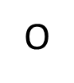

`X' plays first
 | X | O
 | O | X
X considers the game now
 | X | O
 | X | X
 | X
O considers the game now
 |  | O
 |  | X
 | X | O
 |  | X
 | X | O
 |  | X
X considers the game now

Slide 42
Game Tree Othello 4
 | X | O
 | O | X
MAX(X)
 | X | O
 | X | X
 | X
MIN(O)
MAX(X)
O | O | O
 | X | X
 | X
 | X | O
 | O | X
O | X
 | X | O
 | X | O
 | X | O
X
O | X | O
 | X | X
 | X
 | X
O | X | O
 | X | X
 | X
 |  | X
O | O | X
 | X | X
 | X
 |  |  | X
O | O | X
 | X | X
 | X
 |  |  | X
 | X | X
 | X | O
 | X | O
 | X | X | X
 | X | X
 | X | O
 | X | O
 | X | X | X
 | X | O
 | X | O
 | X | X
 | X | X | X
 | X | O
X | X | X
O | X
 |  | X
 | X | X
 | O | X
O | X
 | X | X | X
 | O | X
O | X
MIN(O)

Slide 43
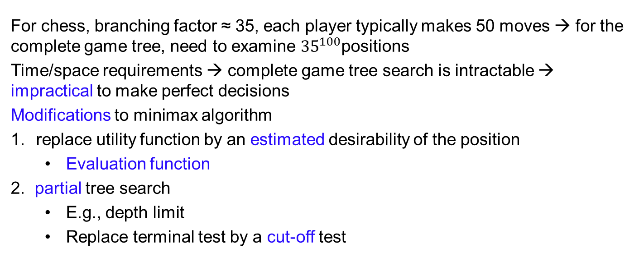
Imperfect Decisions
For chess, branching factor ≈ 35, each player typically makes 50 moves → for the complete game tree, need to examine ${35}^{100}$positions
Time/space requirements → complete game tree search is intractable → impractical to make perfect decisions
Modifications to minimax algorithm
replace utility function by an estimated desirability of the position
Evaluation function
2. partial tree search
E.g., depth limit
Replace terminal test by a cut-off test
Notes:
Why do we need evaluation function? Because we never know the exact truth.

Slide 44




Evaluation Functions
Returns an estimate of the expected utility of the game from a given position
Black: to move
White: slightly better
White: to move
Black: winning

Slide 45
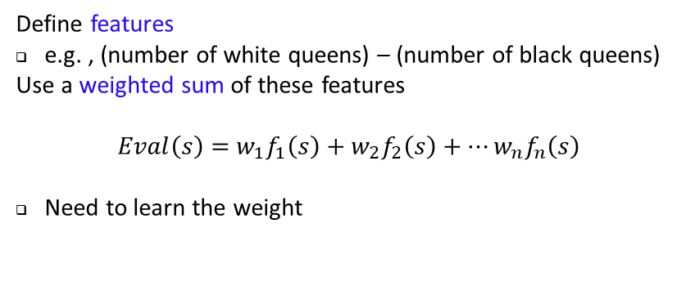
Evaluation Functions...
Requirements
Computation is efficient
Agrees with utility function on terminal states
Accurately reflects the chances of winning
Trade off between accuracy and efficiency
Example (Chess)
R
Define features
e.g. , (number of white queens) – (number of black queens)
Use a weighted sum of these features
$Eval\left(s\right)=$ $w_{1}f_{1}\left(s\right)+w_{2}f_{2}\left(s\right)+…w_{n}f_{n}\left(s\right)$
Need to learn the weight
Notes:
admissible

Slide 46
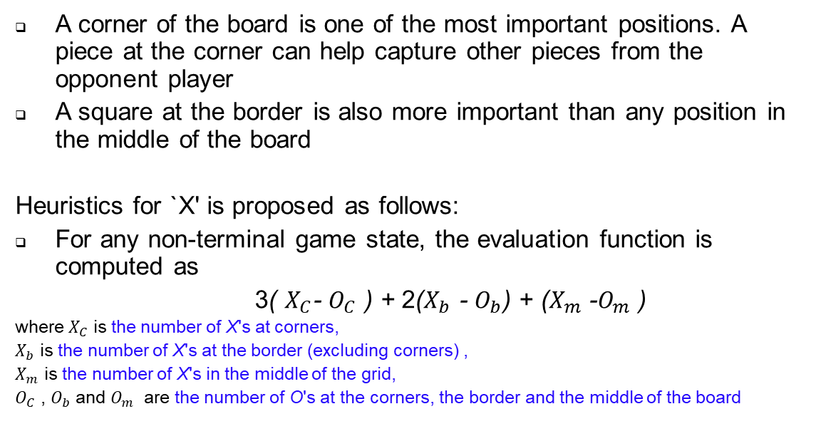
Evaluation Functions for Othello 4
A corner of the board is one of the most important positions. A piece at the corner can help capture other pieces from the opponent player
A square at the border is also more important than any position in the middle of the board
Heuristics for `X' is proposed as follows:
For any non-terminal game state, the evaluation function is computed as
3( $X_{C}$- $O_{C}$ ) + 2($X_{b}$ - $O_{b}$) + ($X_{m}$ -$O_{m}$ )
where $X_{C}$ is the number of X's at corners,
$X_{b}$ is the number of X's at the border (excluding corners) ,
$X_{m}$ is the number of X's in the middle of the grid,
$O_{C}$ , $O_{b}$ and $O_{m}$ are the number of O's at the corners, the border and the middle of the board

Slide 47
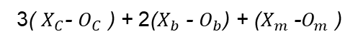
Evaluation Functions for Othello 4 ...
 | X | O
 | O | X
MAX(X)
 | X | O
 | X | X
 | X
MIN(O)
3( $X_{C}$- $O_{C}$ ) + 2($X_{b}$ - $O_{b}$) + ($X_{m}$ -$O_{m}$ )
MAX(X)
O | O | O
 | X | X
 | X
 | X | O
 | O | X
O | X
 | X | O
 | X | O
 | X | O
X
O | X | O
 | X | X
 | X
 | X
O | X | O
 | X | X
 | X
 |  | X
O | O | X
 | X | X
 | X
 |  |  | X
O | O | X
 | X | X
 | X
 |  |  | X
 | X | X
 | X | O
 | X | O
 | X | X | X
 | X | X
 | X | O
 | X | O
 | X | X | X
 | X | O
 | X | O
 | X | X
 | X | X | X
5
4
4
5
 | X | O
X | X | X
O | X
 |  | X
 | X | X
 | O | X
O | X
 | X | X | X
 | O | X
O | X
5
6
4
9
MIN(O)
3
3
3

Slide 48
Minimax Search for Othello 4
 | X | O
 | O | X
MAX(X)
3
 | X | O
 | X | X
 | X
MIN(O)
3
MAX(X)
O | O | O
 | X | X
 | X
 | X | O
 | O | X
O | X
 | X | O
 | X | O
 | X | O
5
3
9
X
O | X | O
 | X | X
 | X
 | X
O | X | O
 | X | X
 | X
 |  | X
O | O | X
 | X | X
 | X
 |  |  | X
O | O | X
 | X | X
 | X
 |  |  | X
 | X | X
 | X | O
 | X | O
 | X | X | X
 | X | X
 | X | O
 | X | O
 | X | X | X
 | X | O
 | X | O
 | X | X
 | X | X | X
5
4
4
5
 | X | O
X | X | X
O | X
 |  | X
 | X | X
 | O | X
O | X
 | X | X | X
 | O | X
O | X
5
6
4
9
MIN(O)
3
3
3
Notes:
For incomplete tree,

Slide 49




Quiescent Search
The evaluation function should only be applied to quiescent positions
positions that are not likely to have large variations in evaluation in the near future
Example (Chess)
R
Positions in which favorable captures can be made
Black: to move
White: about to lose
Expansion of non-quiescent positions until quiescent positions are reached
Notes:
Cut off at quiescent postion, this is just a heursitic

Slide 50
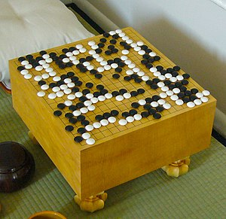
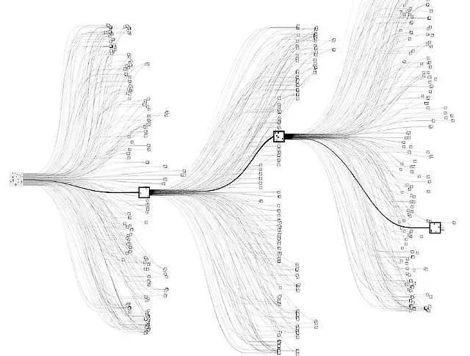
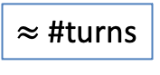

Revisit: Alpha Go
$≈$ #turns
#Moves = 250¹⁵⁰
$≈$ #stone positions

Slide 51
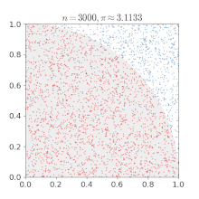
Another Example: Monte Carlo Search Tree (MCST)

Slide 52
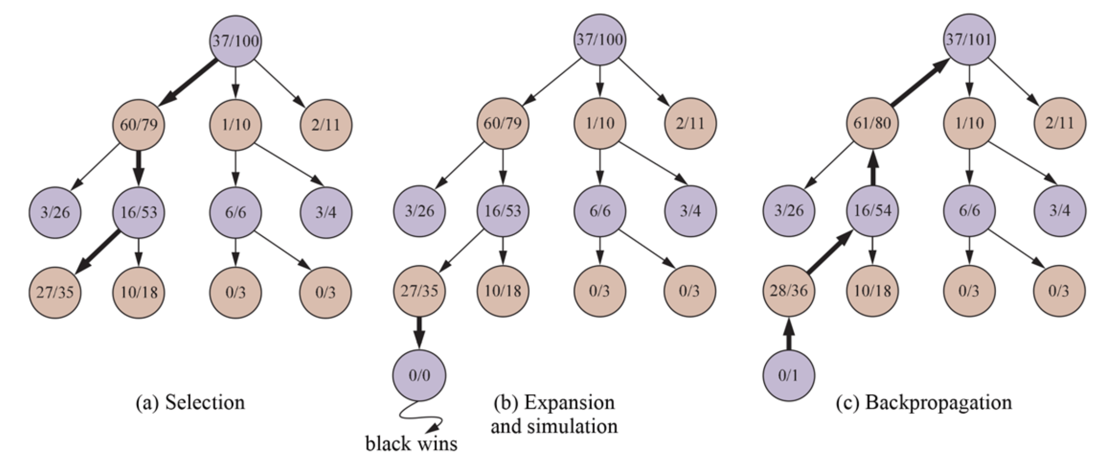
MCST Key Steps
#Wins/#Games

Slide 53
MCST for Go is very expensive & slow
Why? The deeper you move, the wider you are
→
#number of simulations is exploded
Solution:
For selection/expansion, no longer stats (xx/xx) but f = g+h
For simulation, no longer real self-play but f = g+h

Slide 54
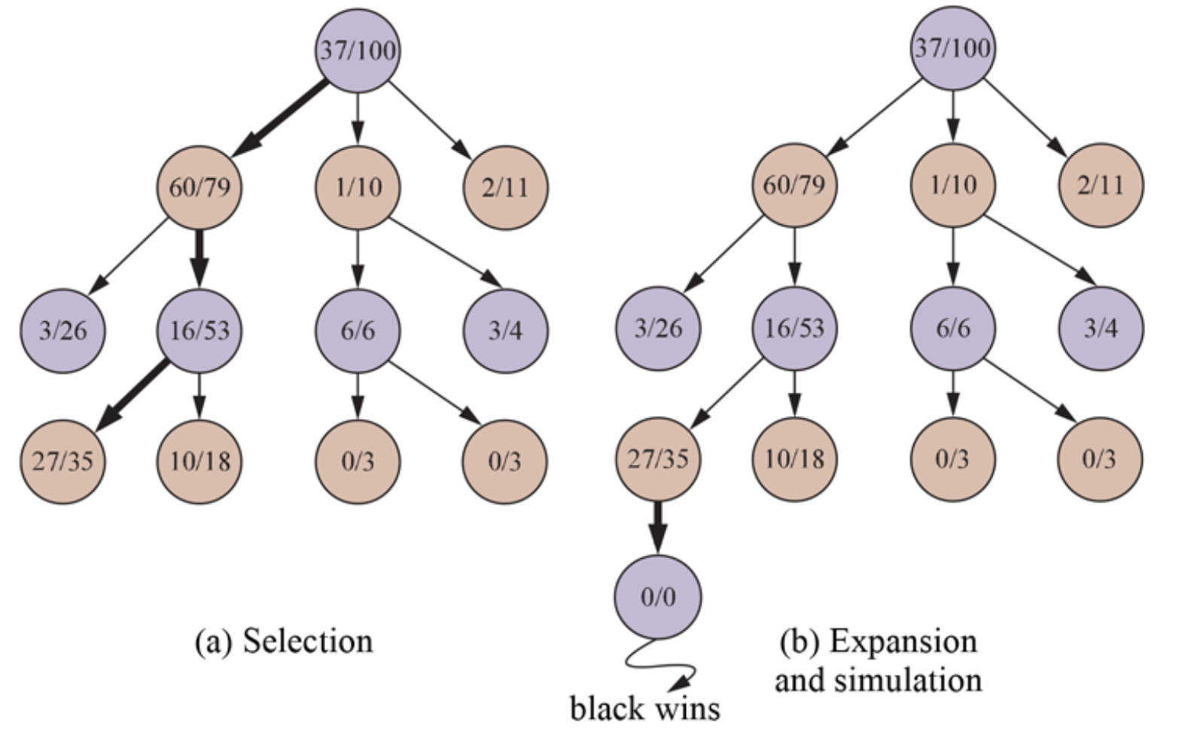
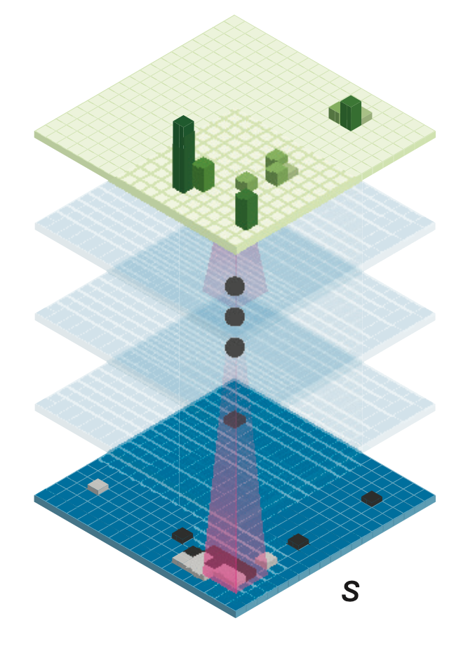



MCST: Update f = g() + h()
Policy Network
Value Network
f
f
$$g( )$$
$$h( )$$
f
f
f
f
f
f
f
f
f
f
f
f
f
f
f
f
f
f
f
f
f
f
f
No real play,
just an estimation

